Slide 1
Machine Language
Nouman M Durrani

Slide 2
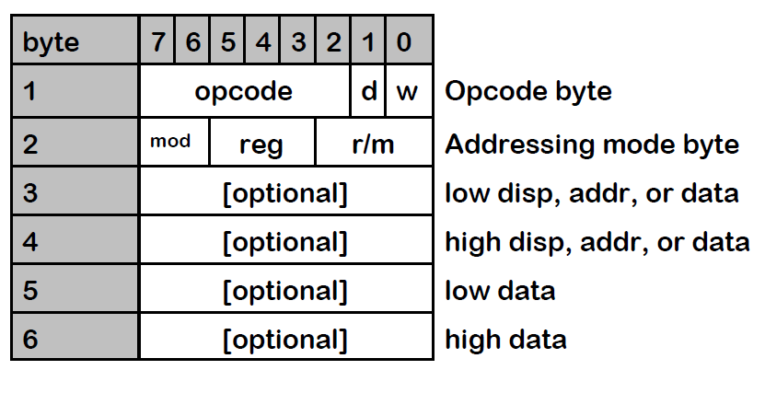
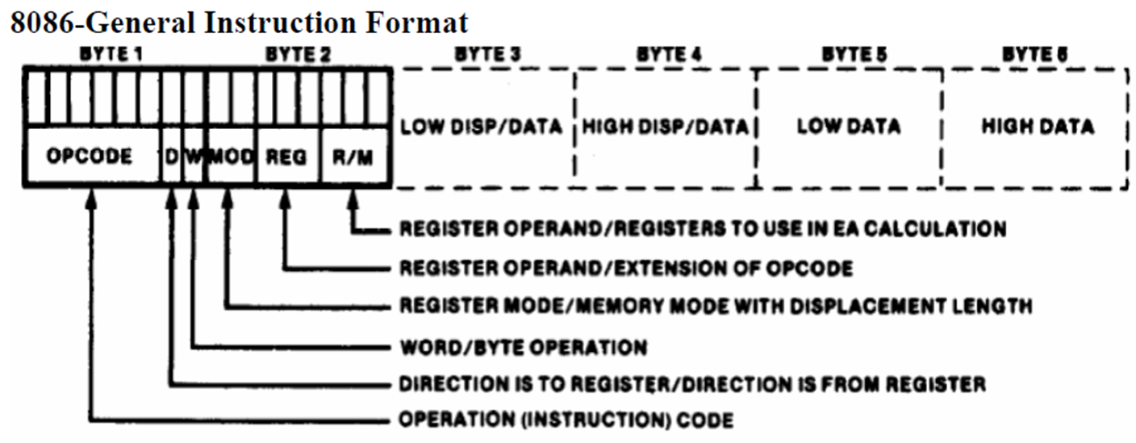
Instruction Format

Slide 3
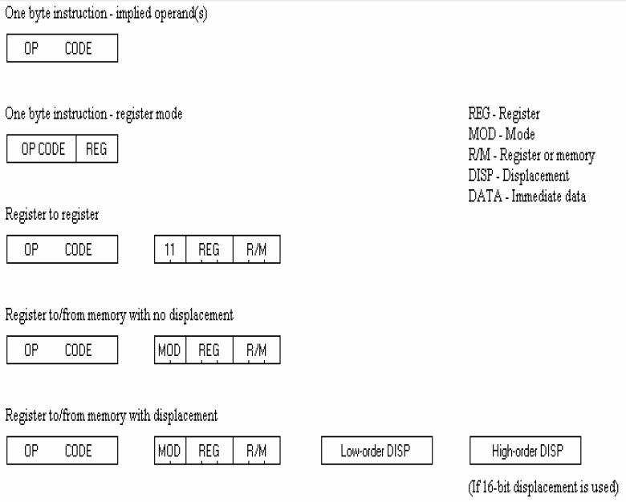

Slide 4
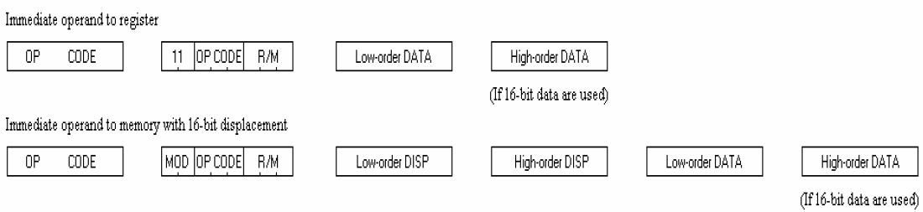

Slide 5
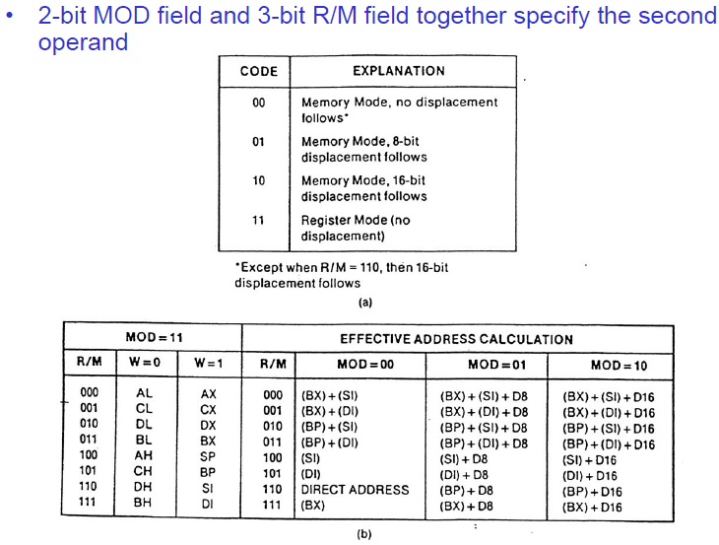
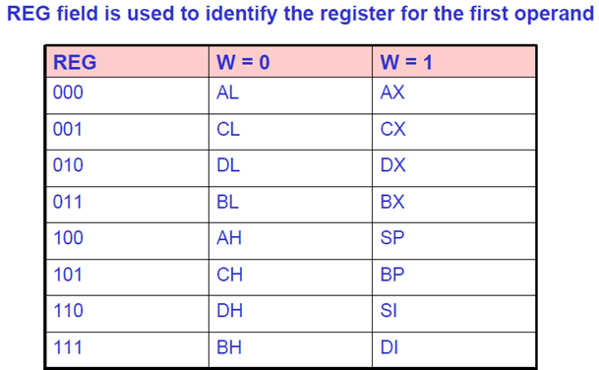
Segment Override
00 | ES
01 | CS
10 | SS
11 | DS

Slide 6
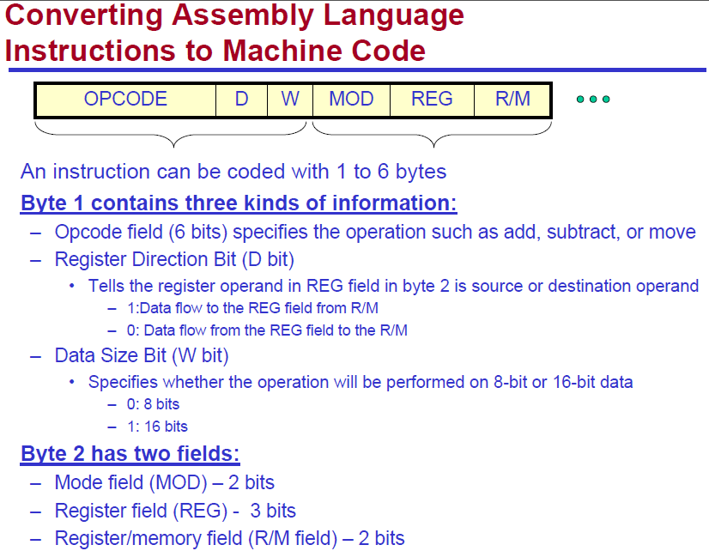
(1 bit) Direction. 1 = Register is Destination, 0 = Register is source.

Slide 8
Segment Override
00 | ES
01 | CS
10 | SS
11 | DS

Slide 9
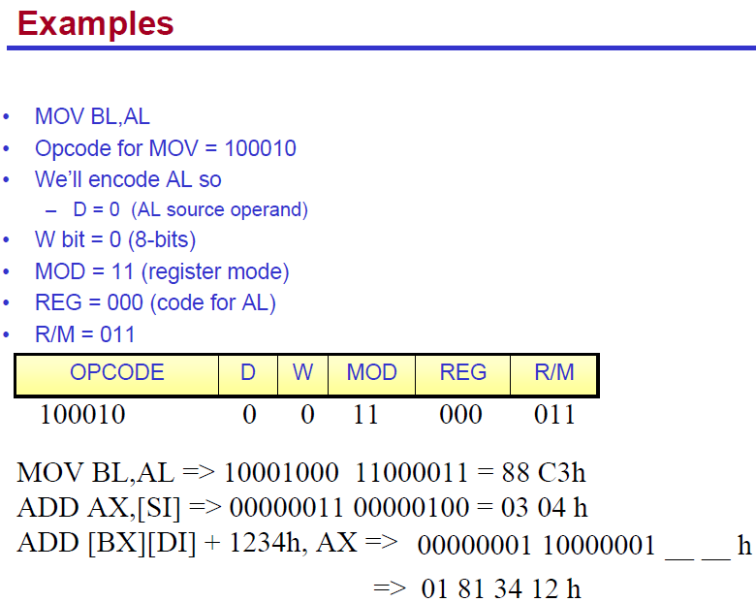
D=0 when Data moving from a register

Slide 10
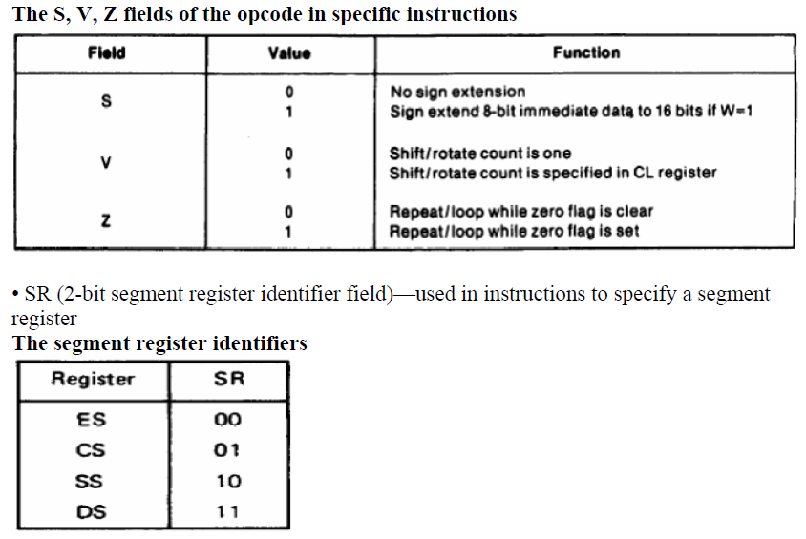
In some cases, S, V and Z are used before w

Slide 11
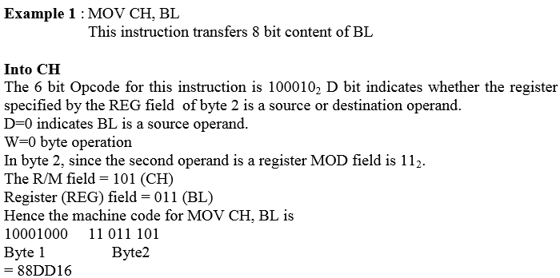

Slide 12
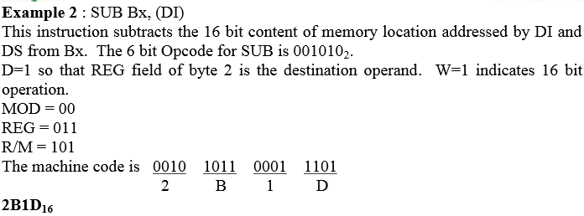

Slide 13
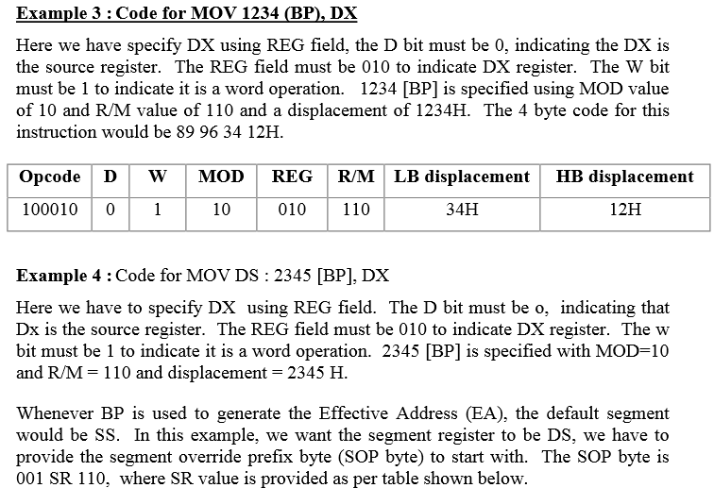

Slide 14
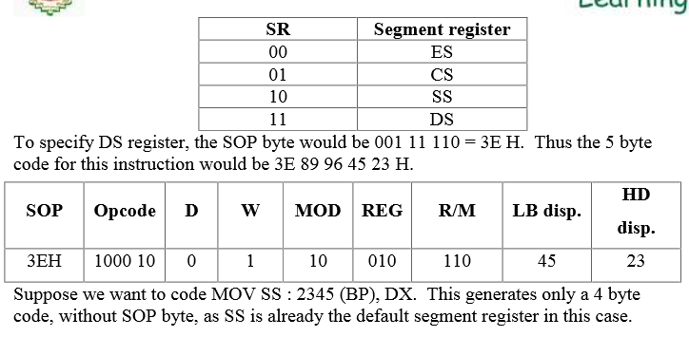

Slide 15
